Slide 1
GTÜ CSE 495 and 496 Striker
BIL 495
Third Presentation
Derviş Ali Duman
Proje Danışmanı: Dr. Alp Arslan BAYRAKÇI
January 2023

Slide 2
Content
Image Processing
Is Shot Goal ?
Shooting Mechanism
Used Components
Completed Machine
Machine learning
What I have done
Conclusion

Slide 3
Description
In this project, I wanted to design a machine that detects the football goal and the ball from its color, and then combines the shoot parameters with the result of whether there is a goal or not with machine learning.
It is expected that machine will train itself with every shot it thrown by adjusting the angle, and gradually make more accurate shots with each shot through machine learning.

Slide 4
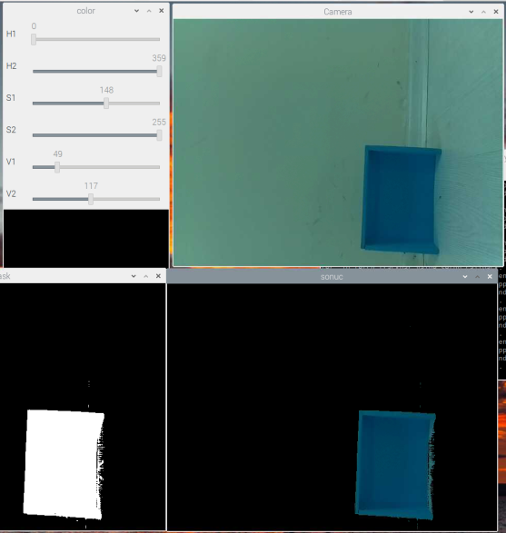
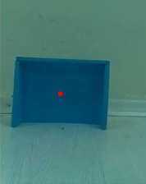
Image Processing
I reformatted image BGR to HSV .For the color mask, it needs HSV values. So, I used HSV tracker for the right range of color.
There is white spaces when we applied a mask in that specific color detected places.
Lastly found contours for finding biggest white space and it’s center.

Slide 5
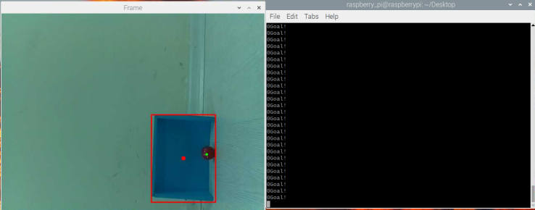
Is Shot Goal ?
It compares the region of countours that collected from blue goal and red ball then it will calculates the contour areas for if ball is in the goal or not.

Slide 6
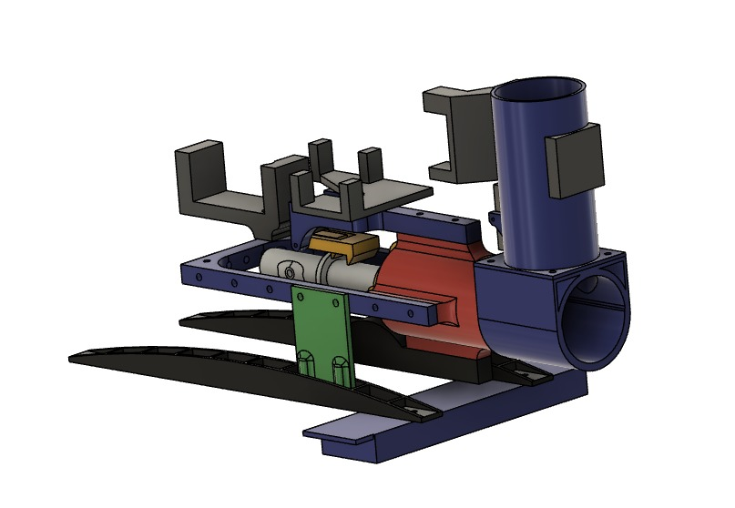
Used Components
There 4 servo motors for shooting mechanism,
2 motor wheels for setting angles,
1 motor driver for wheel motors,
2 battery pack,
1 powerbank,
1 camera.

Slide 7
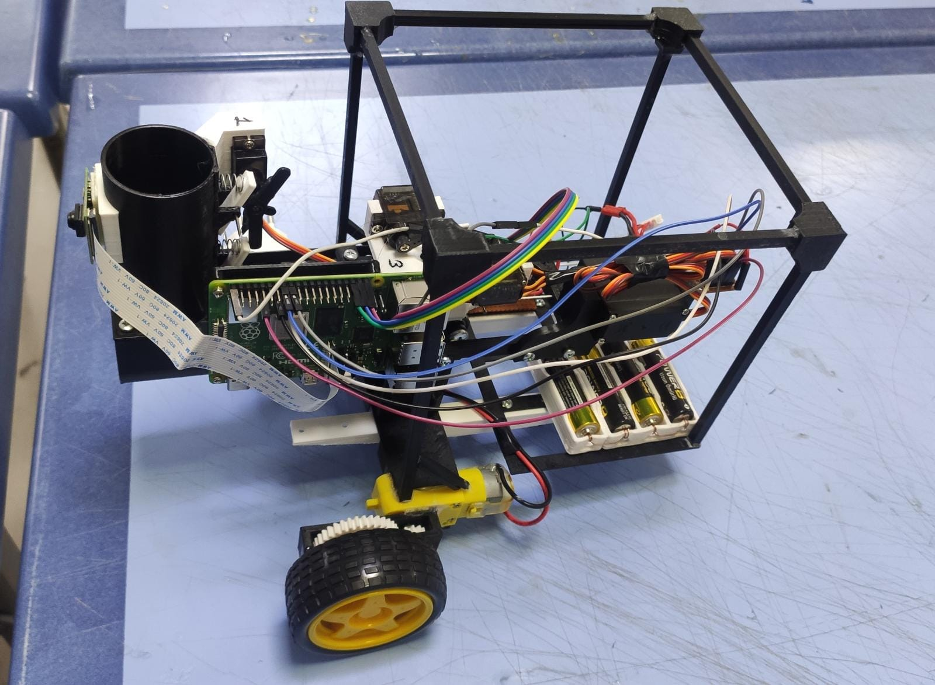
Completed Machine
Most of the mechanical parts used in the project were 3D printed. These 3D printed parts include battery and power bank slots, wheels for make the wheel turn slowly, a magazine that allows extra balls to be thrown, the servo in the last of the machine that allows the rope to be pulled at 90 degrees.

Slide 8
What I’ve done
Done:
Designing the baseline of the robot.
Detecting soccer goal and ball images.
Mechanism can aim and shoot the ball.
Making sure the robot can detect if it was a score or not.
Adding more hardware like motor driver. Stabilizing the shooting mechanism if everything is okay for the machine learning.
Train the machine for more accurate shots for different angles and different distance.

Slide 9
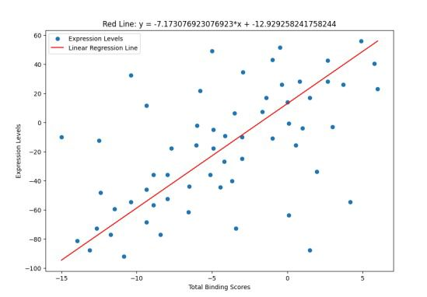
Machine learning
I used linear regression model for this Project. It is trained for more acurate shots.

Slide 10
Conclusion
Machine can get a score with different size of goals.
Machine can get a score with different angles from the soccer goal.
Machine can get a score at 10 meters but the machine can't tell if a goal is scored at more than 5 meters because it can't see the ball with this insufficient camera.
Machine Learning has %85 accuracy while shooting.

Slide 11
Resources
https://opencv.org
https://matplotlib.org/

